Slide 1

Object Oriented Programming with C#
CS107.3
Lecture #05
Pramudya Thilakaratne pramudya.h@nsbm.ac.lk
Lecturer
Faculty of Computing
NSBM Green University

Slide 2
Welcome to Lecture 05!
Take your notebooks and prepare
You can ask questions via either chat message or over the mic.
When you are not using the mic please mute it.

Slide 3

From Last Week
C# Arrays

Slide 4
OOP
OOP is a programming paradigm based on the concepts of objects
There are four major OOP concepts:
Encapsulation – Package the variables and functions into a single unit
Abstraction - Show only the essentials to the outside use
Inheritance – Inherit common variables and functions
Polymorphism – Function the object depending on the data

Slide 5
Access Specifiers [ Access Modifiers ]
Encapsulation is implemented by using access specifiers.
An access specifier defines the scope and visibility of a class member.
C# supports the following access specifiers
Public
Private
Protected
Internal
Protected Internal

Slide 6
Public Access Specifier
Public access specifier allows a class to expose its member variables and member functions to other functions and objects.
Any public member can be accessed from outside the class.

Slide 7
Private Access Specifier
Private access specifier allows a class to hide its member variables and member functions from other functions and objects.
Only functions of the same class can access its private member.

Slide 8
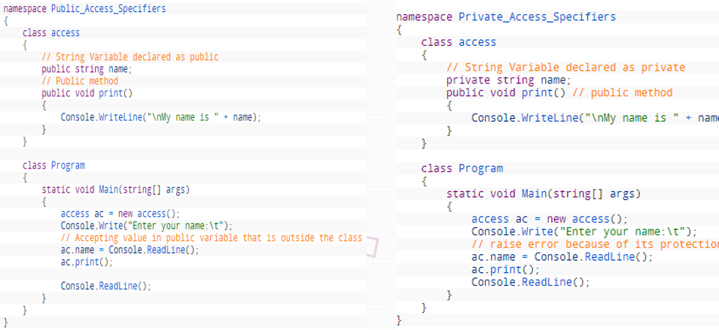

Slide 9
Protected Access Specifier
Protected access specifier allows a child class to access the member variables and member functions of its base class.
This way it helps in implementing inheritance (OOP concept you will learn in coming weeks).

Slide 10
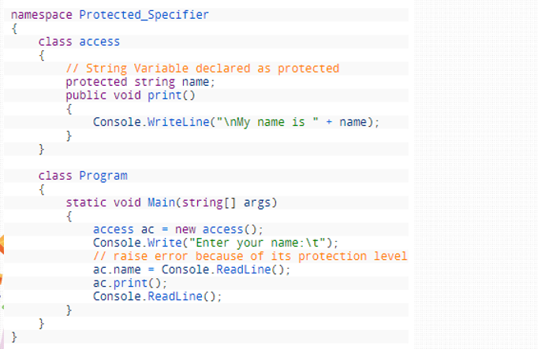

Slide 11
Encapsulation
Encapsulation is one of the fundamental in OOP concepts.
Encapsulation is the technique of making the fields in a class private and providing access to the fields via public methods.
If a field is declared private, it cannot be accessed by anyone outside the class, thereby hiding the fields within the class.

Slide 12
Encapsulation
For this reason, Encapsulation is also referred to as Data Hiding.
Encapsulation can be described as a protective barrier that prevents the code and data being randomly accessed by other code defined outside the class.
The main benefits of encapsulation is the ability to modify our implemented code without breaking the code of others who use our code.
With this features Encapsulation gives Maintainability, Flexibility and Extensibility to our code.

Slide 13
C# GET SET Accessors / Getters and Setters
The get set accessors or modifiers mostly used for storing and retrieving value from the private field.
In simple word, the get method used for retrieving value from private field where set method used for storing value in private variables.

Slide 14
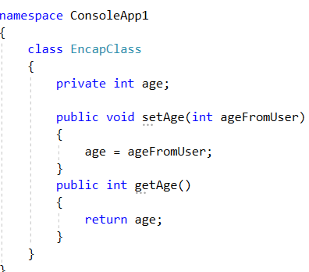
C# Getters and Setters Sample Code

Slide 15
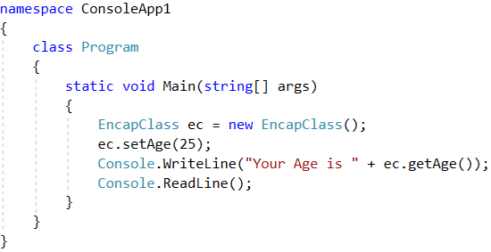
C# Getters and Setters Sample Code

Slide 16
C# Getters and Setters Task 01
Now add a getter and setter for private variable call ‘name’ to the above code.

Slide 17
C# Getters and Setters Task 02 Encapsulation
Write a complete C# code to declare two private integer variables to accept user inputs and display the sum of those two values
Hint – Take a separate class which contain get and set methods.

Slide 18


